Slide 1
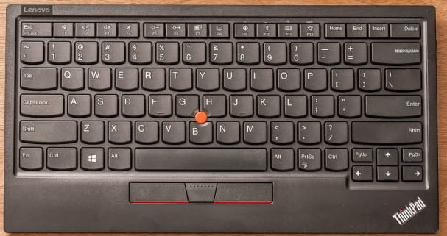
Esc – close or cancel
W – select front sail
R – restart game
F11 – full screen in/out
P – pause / play toggle
- (minus) for Zoom In
+ (plus) for Zoom Out
S – select main sail
A – toggle ANCHOR
Up arrow – release sails
Enter – OK or close
X – track boat/world
K – show/hide GUI widgets
Left Shift – hit rudder to the left
? / - show this help info
Right Shift – hit rudder to the right
Page Down – lower the keel
Page Up – raise the keel
Cntr + C – quit the game
Legend:
Navigations
Game controls
Left arrow – rudder to left
Down arrow – pull sails
Right arrow – rudder to right
Dialogs control

Slide 2
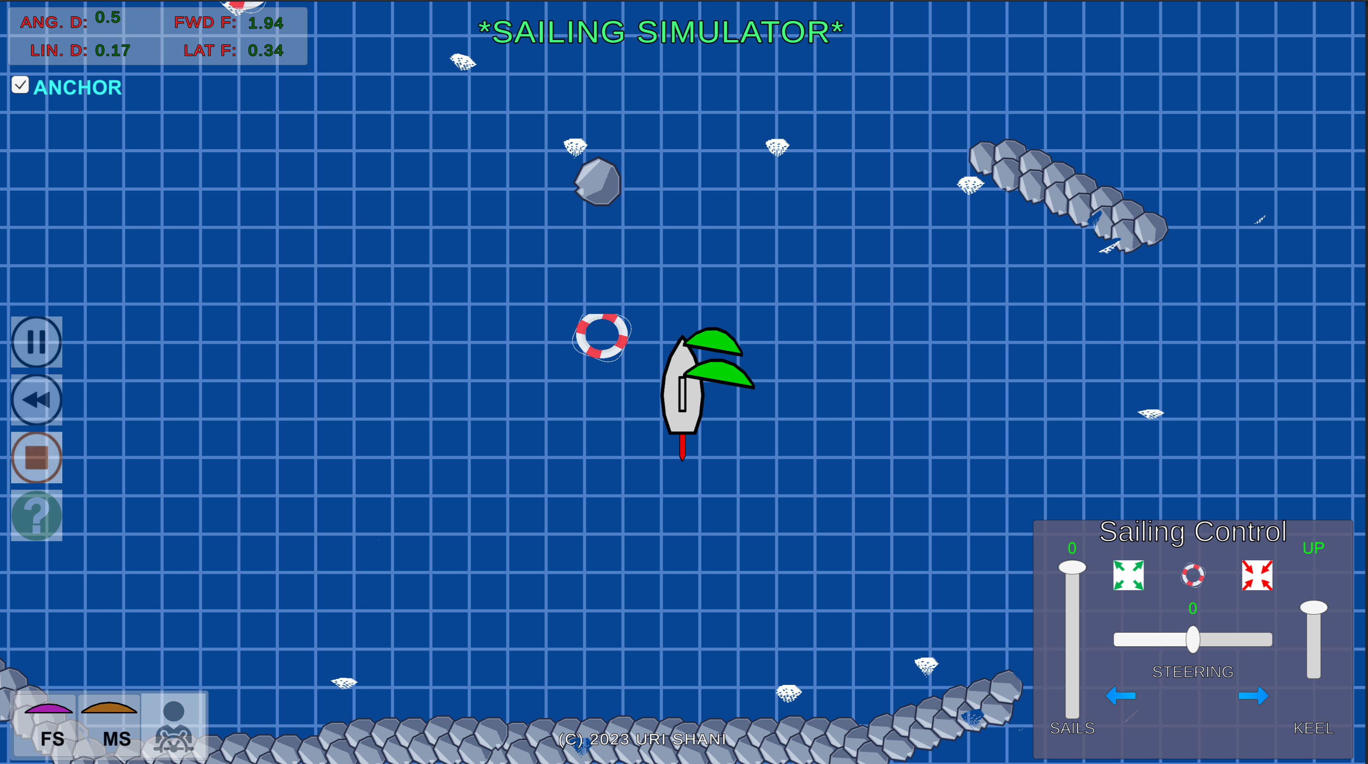
Toggle ANCHOR
Info about boat Drag
Info about wind Force
Anchored buoy
“waives”
Rock
Waves breaker
Toggle Full screen
Pause / Play toggle
Restart game
Zoom in/out
Quit the game
Man in water drill
Show help info/tutorial
Lower/raise Keel
Legend:
Navigate
Controls
Front sail
Main sail
Toggle track boat/world
Pull/Release Sails
Steer Left/Right
Hit rudder to right/left
Info
Obstacles

Slide 3
Z
Z
F11

